Slide 1


R. GLENN
HUBBARD
ANTHONY PATRICK
O’BRIEN
FIFTH EDITION
© 2015 Pearson Education, Inc.

Slide 2
Economics:
Foundations and Models

Slide 3
What is this class about?
People make choices as they try to attain their goals. Choices are necessary because we live in a world of scarcity.
Scarcity: A situation in which unlimited wants exceed the limited resources available to fulfill those wants
Economics is the study of these choices.
Economists study these choices using economic models, simplified versions of reality used to analyze real-world economic applications.

Slide 4
Typical “economics” questions
We will learn how to answer questions like these:
  • How are the prices of goods and services determined?
  • How does pollution affect the economy, and how should government policy deal with these effects?
  • Why do firms engage in international trade, and how do government policies affect international trade?
  • Why does government control the prices of some goods and services, and what are the effects of those controls?

Slide 5
Three Key Economic Ideas
1.1
Explain these three key economic ideas:
People are rational,
People respond to incentives, and
Optimal decisions are made at the margin.

Slide 6
1. People are rational
Economists generally assume that people are rational.
Rational: Using all available information to achieve your goals.
Rational consumers and firms weigh the benefits and costs of each action, and try to make the best decision possible.
Example: Microsoft doesn’t randomly choose the price of its Windows software; it chooses the price(s) that it thinks will be most profitable.

Slide 7
2. People respond to incentives
As incentives change, so do the actions that people will take.
Example: Changes in several factors have resulted in increased obesity in Americans over the last couple of decades, including:
Decreases in the price of fast food relative to healthful food
Improved non-active entertainment options
Increased availability of health care and insurance, protecting people against the consequences of their actions

Slide 8
3. Optimal decisions are made at the margin
While some decisions are all-or-nothing, most decisions involve doing a little more or a little less of something.
Example: Should you watch an extra hour of TV, or study instead?
Economists think about decisions like this in terms of the marginal cost and benefit (MC and MB): the additional cost or benefit associated with a small amount extra of some action.
Comparing MC and MB is known as Marginal Analysis.

Slide 9
Health insurance and obesity
Obesity is rising in America, for various reasons.
Is one of those reasons health insurance?
People with health insurance have less incentive to stay healthy than people without health insurance.
Holding constant other factors like age, gender, and income, research shows people with health insurance are more likely to be obese.
They are responding to economic incentives.

Slide 10
The Economic Problem That Every Society Must Solve
1.2
Discuss how an economy answers these questions:
What goods and services will be produced?
How will the goods and services be produced?
Who will receive the goods and services produced?

Slide 11
1. What goods and services will be produced?
Individuals, firms, and governments must decide on the goods and services that should be produced.
An increase in the production of one good requires the reduction in the production of some other good. This is a trade-off, resulting from the scarcity of productive resources.
The highest-valued alternative given up in order to engage in some activity is known as the opportunity cost.
Example: the opportunity cost of increased funding for space exploration might be giving up the opportunity to fund cancer research.

Slide 12
2. How will the goods be produced?
A firm might have several different methods for producing its goods and services.
Example: A music producer can make a song sound good by
Hiring a great singer, and using standard production techniques; or
Hiring a mediocre singer, and using Auto-Tune to correct the inaccuracies.
Example: As the cost of manufacturing labor changes, a firm might respond by
Changing its production technique to one that employs more machines and fewer workers; or even
Moving its factory to a location with cheaper labor

Slide 13
3. Who will receive the goods and services?
The way we are most familiar with in the United States is that people with higher incomes obtain more goods and services.
Changes in tax and welfare policies change the distribution of income; though people often disagree about the extent to which this “redistribution” is desirable.

Slide 14
Types of economies
Centrally planned economies result when governments decide what to produce, how to produce it, and who received the goods and services.
Market economies result when the decisions of households and firms determine what is produced, how it is produced, and who receives the goods and services.
Market: A group of buyers and sellers of a good or service
Mixed economies have features of both of the above. Most economic decisions result from the interaction of buyers and sellers, but governments play a significant role in the allocation of resources.

Slide 15
Efficiency of economies
Market economies tend to be more efficient than centrally-planned economies.
Market economies promote:
Productive efficiency, where goods or services are produced at the lowest possible cost; and
Allocative efficiency, where production is consistent with consumer preferences: the marginal benefit of production is equal to its marginal cost
These efficiencies come about because all transactions result from voluntary exchange: transactions that make both the buyer and seller better off.

Slide 16
Caveats about market economies
Markets may not result in fully efficient outcomes. For example:
People might not immediately do things in the most efficient way
Governments might interfere with market outcomes
Market outcomes might ignore the desires of people who are not involved in transactions – ex: pollution
Economically efficient outcomes may not be the most desirable. Markets result in high inequality; some people prefer more equity, i.e. fairer distribution of economic benefits.

Slide 17
Economic Models
1.3
Understand the role of models in economic analysis.

Slide 18
Economic models
Economists develop economic models to analyze real-world issues.
Building an economic model often follows these steps:
  Decide on the assumptions to use in developing the model.
  Formulate a testable hypothesis.
  Use economic data to test the hypothesis.
  Revise the model if it fails to explain the economic data well.
  Retain the revised model to help answer similar economic questions in the future.

Slide 19
Important features of economic models
Assumptions and simplifications: every model needs them in order to be useful.
Testability: good models generate testable predictions, which can be verified or disproven using data.
Economic variables: something measurable that can have different values, such as the incomes of doctors.

Slide 20
The scientific nature of economics
Economists try to mimic natural scientists by using the scientific method. But economics is a social science; studying the behavior of people is often tricky.
When analyzing human behavior, we can perform:
Positive analysis: the study of “what is?”; and/or
Normative analysis: the study of “what ought to be?”
Economists generally perform positive analysis.

Slide 21
Should medical school be free?
Forecasts indicate a significant shortage of doctors, especially primary care physicians, by 2020.
High costs of medical school may:
Prevent some people from becoming doctors
Lead people to pursue lucrative specialties instead of primary care
Would more people become primary care physicians if medical school were free? And if so, would it be worth the cost?
Economic models can find answers to the positive aspects of this debate.

Slide 22
Microeconomics and Macroeconomics
1.4
Distinguish between microeconomics and macroeconomics.

Slide 23
Microeconomics and macroeconomics
Microeconomics is the study of
how households and firms make choices,
how they interact in markets, and
how the government attempts to influence their choices
Macroeconomics is the study of the economy as a whole, including topics such as inflation, unemployment, and economic growth.

Slide 24
A Preview of Important Economic Terms
1.5
Define important economic terms.

Slide 25
Terminology in economics
Like all fields of study, economics uses terms or jargon with specific, precise meanings.
Sometimes these terms will be used in ways that differ even from closely related disciplines.
Examples:
Technology: the processes a firm uses for turning inputs into outputs of goods and services
Capital: manufactured goods that are used to produce other goods and services
Pay close attention to terms defined in class and in the textbook!

Slide 26
Common misconceptions to avoid
Believing economics is only about money.
Confusing positive and normative analysis.
Assuming familiar meanings for economic terms.

Slide 27
Appendix: Using graphs and fomulas
Review the use of graphs and formulas.

Slide 28
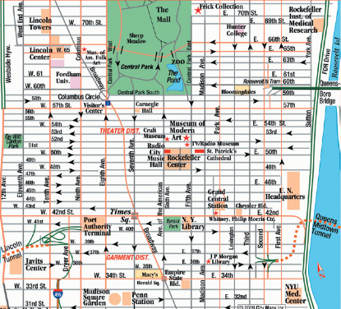
A map as a graphical model
A map is a simplified model of reality, showing essential details only.
Economic models, with features like graphs and formulas, can help us understand economic situations just like a map helps us to understand the geographic layout of a city.
Street map of New York City.
Copyright © 2011 City Maps Inc.

Slide 29
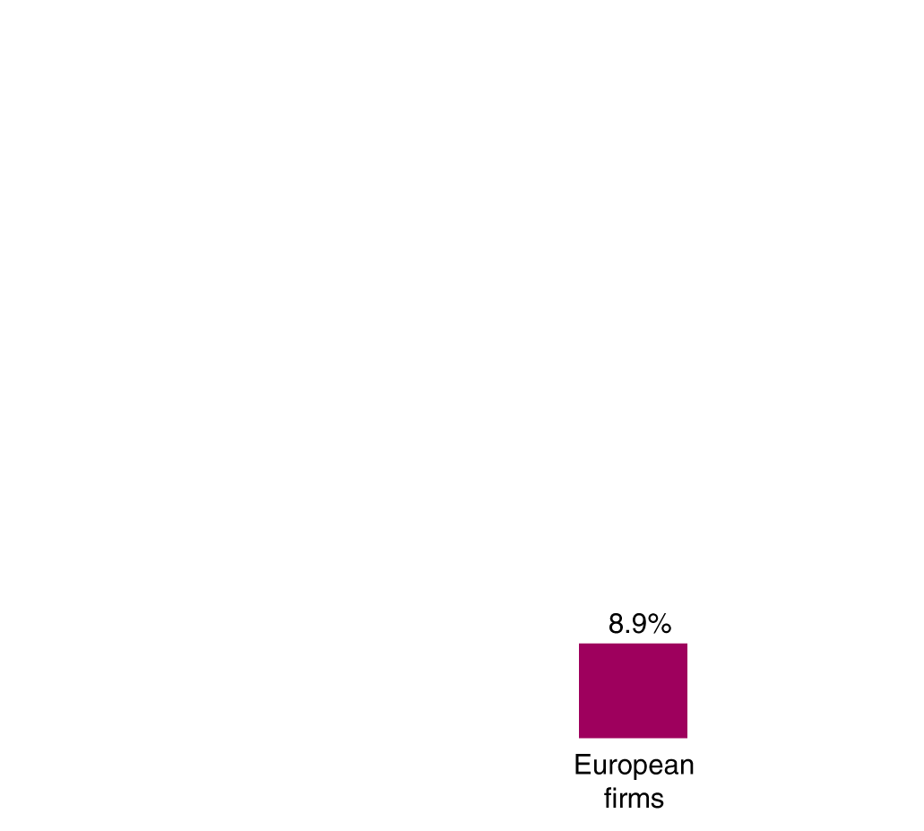
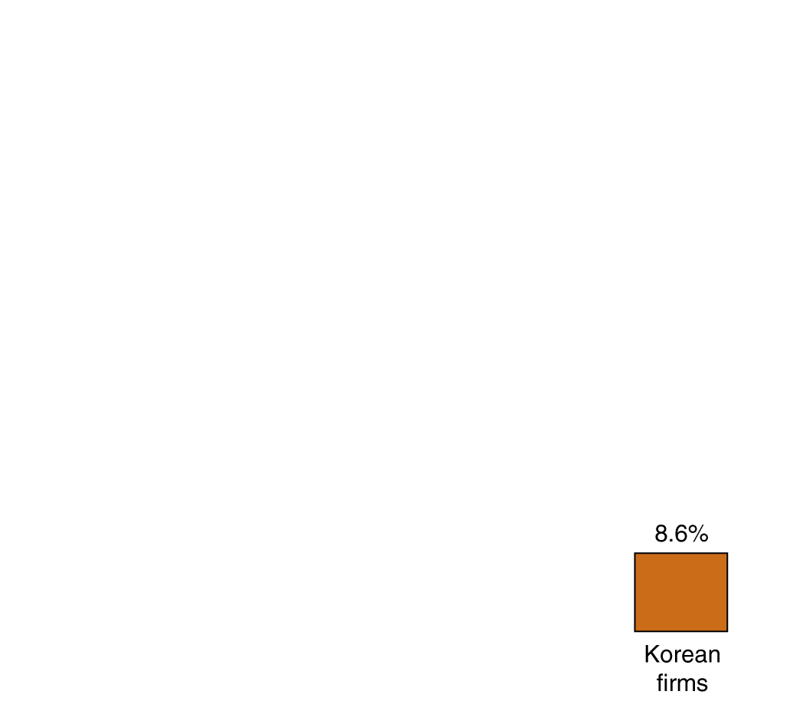
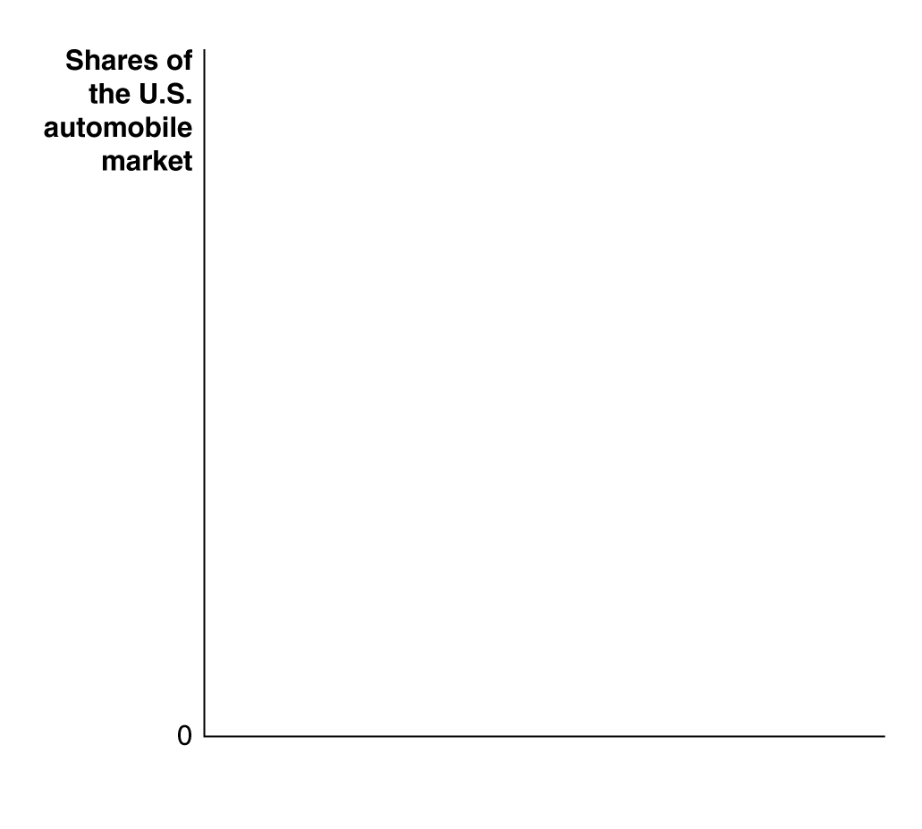
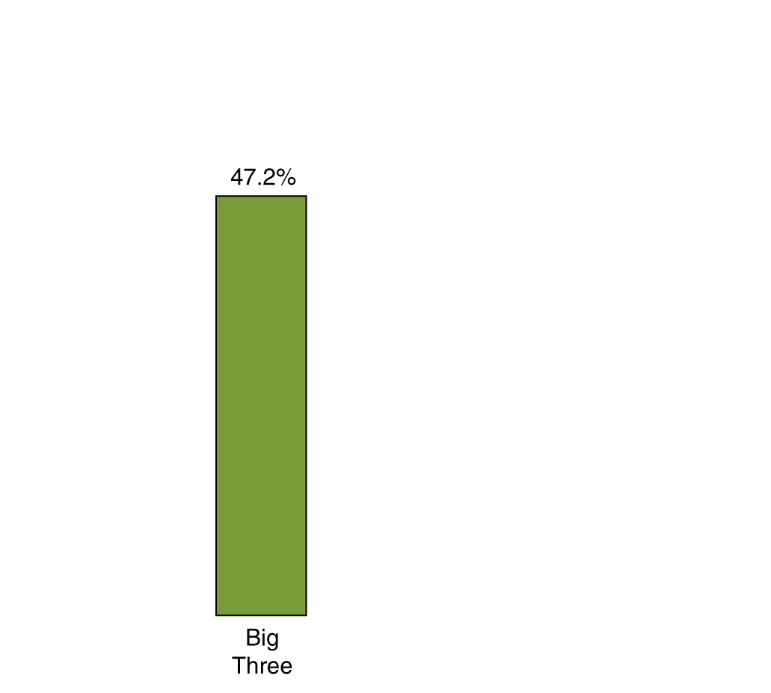
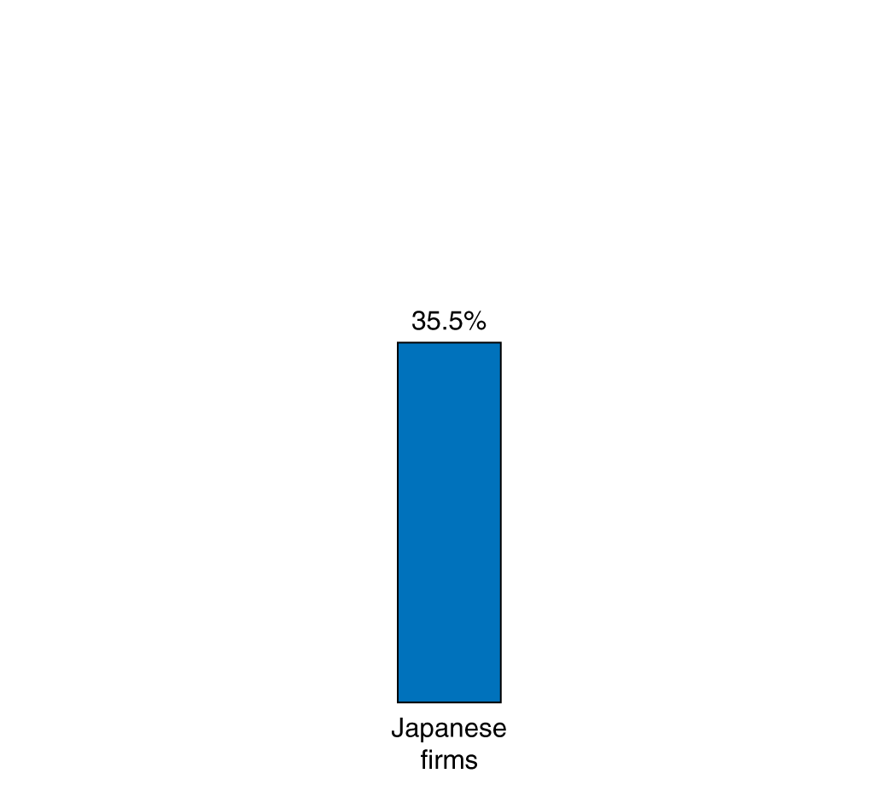
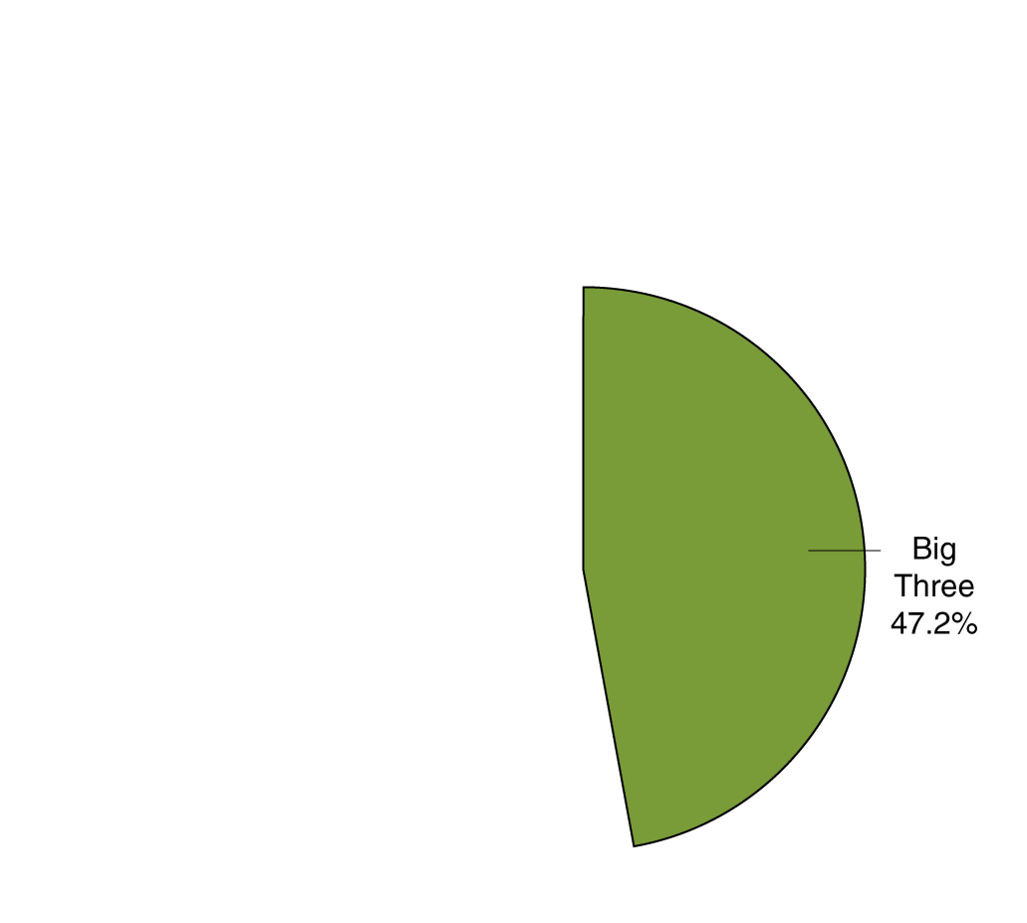
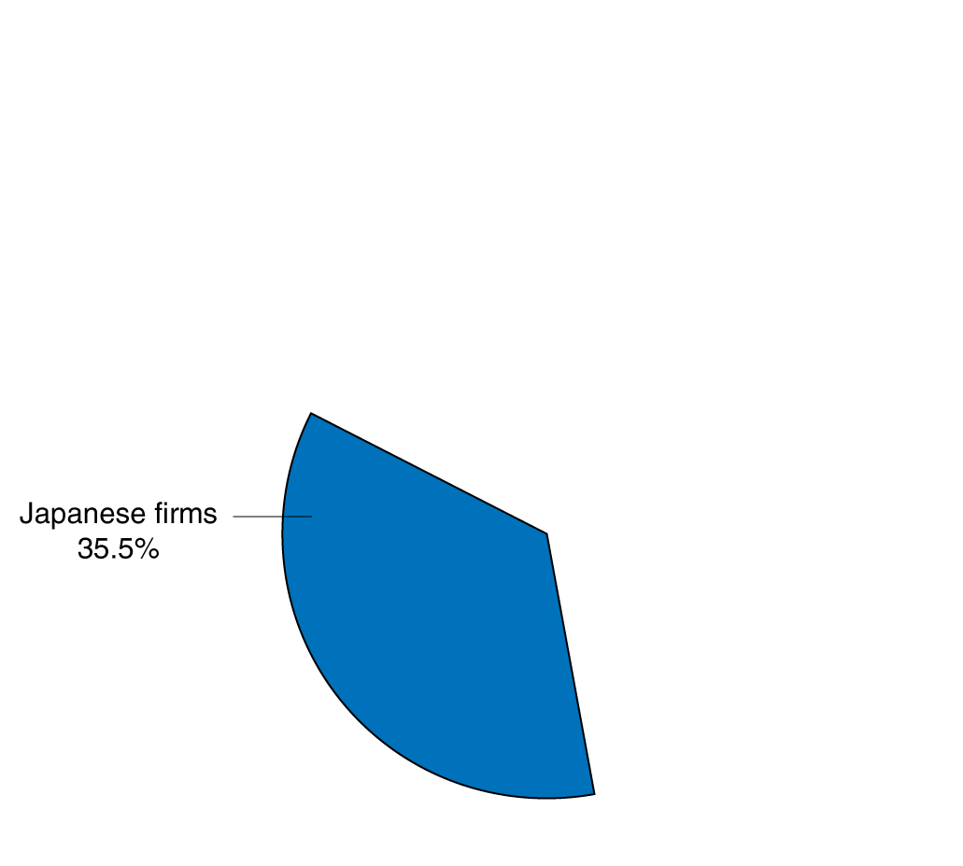
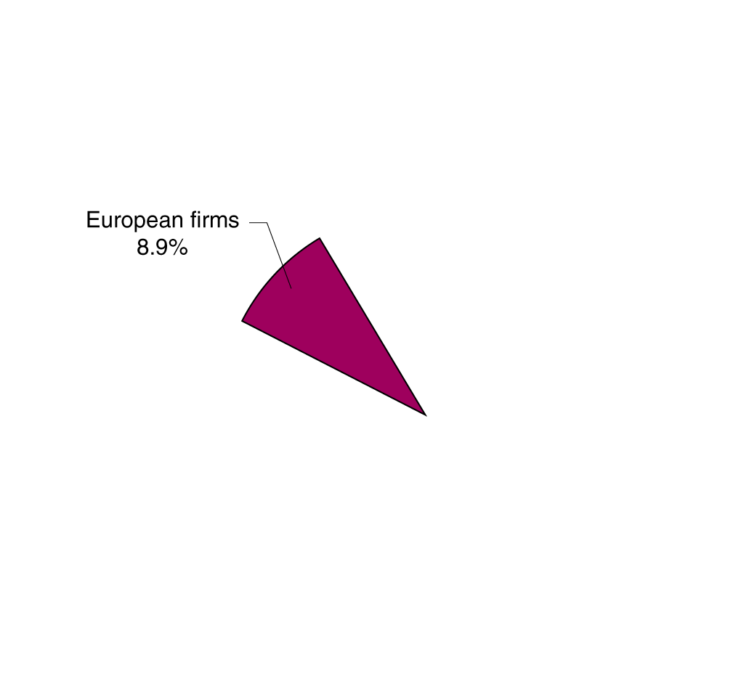
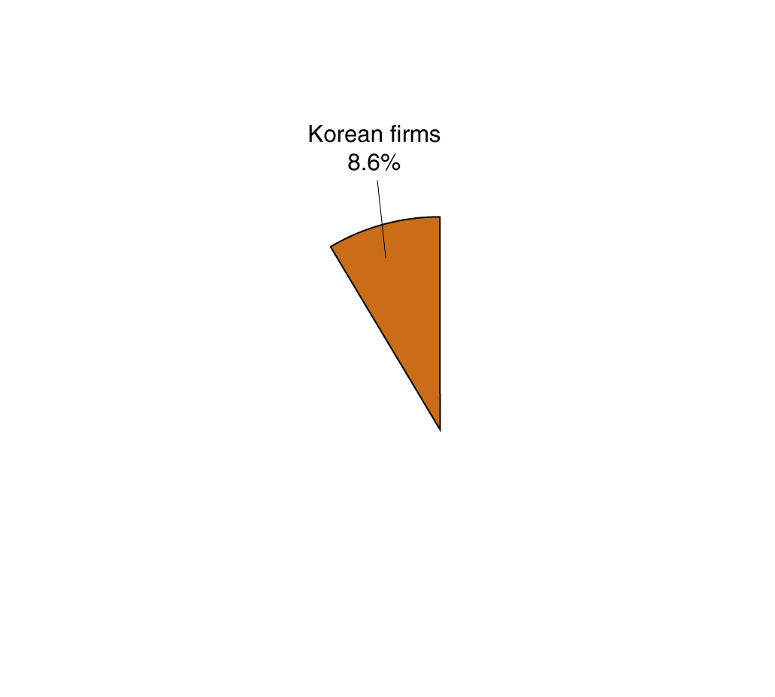
Graphs of one variable
Panel (a) shows a bar graph of market share data for the U.S. automobile industry; market share is represented by the height of the bar.
Panel (b) shows a pie chart of the same data; market share is represented by the size
of the “slice of the pie”.
Figure 1A.1
Bar Graphs and Pie Charts
Notes:
Values for an economic variable are often displayed as a bar graph or a pie chart.
In this case, panel (a) shows market share data for the U.S. automobile industry as
a bar graph, where the market share of each group of firms is represented by the
height of its bar. Panel (b) displays the same information as a pie chart, where the
market share of each group of firms is represented by the size of its slice of the pie.
Source: “Auto Sales,” Wall Street Journal, May 1, 2013.

Slide 30



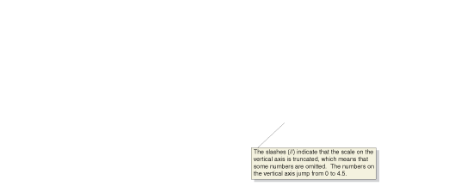
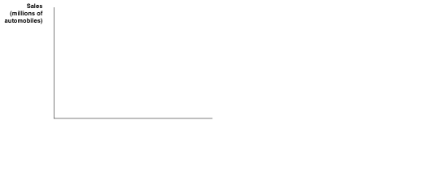






Time-series graphs
Both panels present time-series graphs of Ford Motor Company’s worldwide sales during each year from 2001 to 2010.
Panel (a) has a truncated scale on the vertical axis, and panel (b) does not.
As a result, the fluctuations in Ford’s sales appear smaller in panel (b) than in panel (a).
Figure 1A.2
Time-Series Graphs
Notes:
Values for an economic variable are often displayed as a bar graph or a pie chart.
In this case, panel (a) shows market share data for the U.S. automobile industry as
a bar graph, where the market share of each group of firms is represented by the
height of its bar. Panel (b) displays the same information as a pie chart, where the
market share of each group of firms is represented by the size of its slice of the pie.
Source: “Auto Sales,” Wall Street Journal, May 1, 2013.

Slide 31
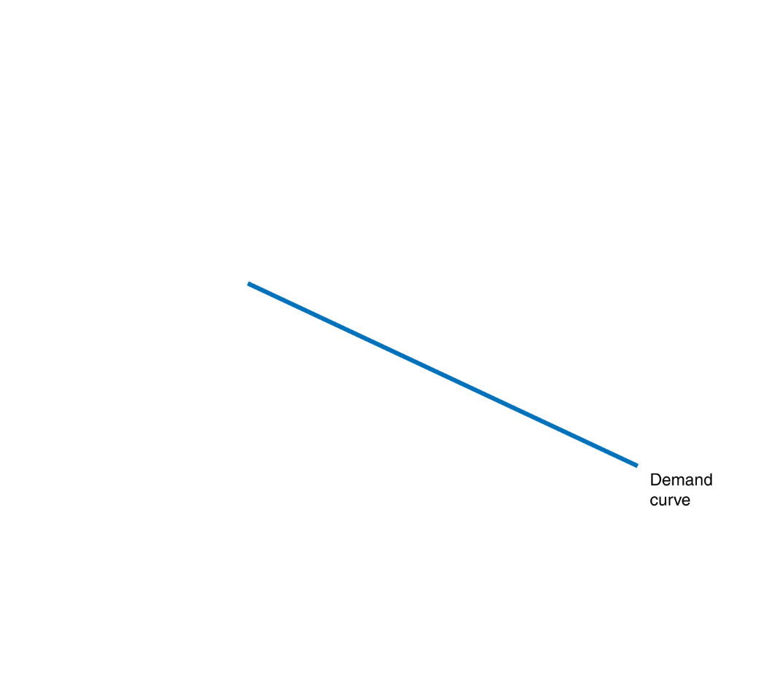
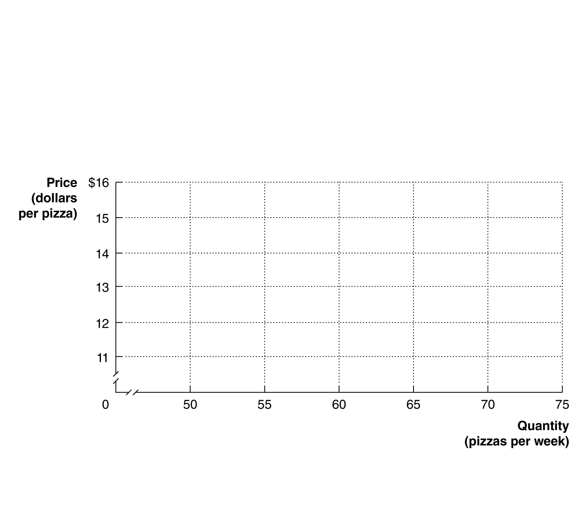
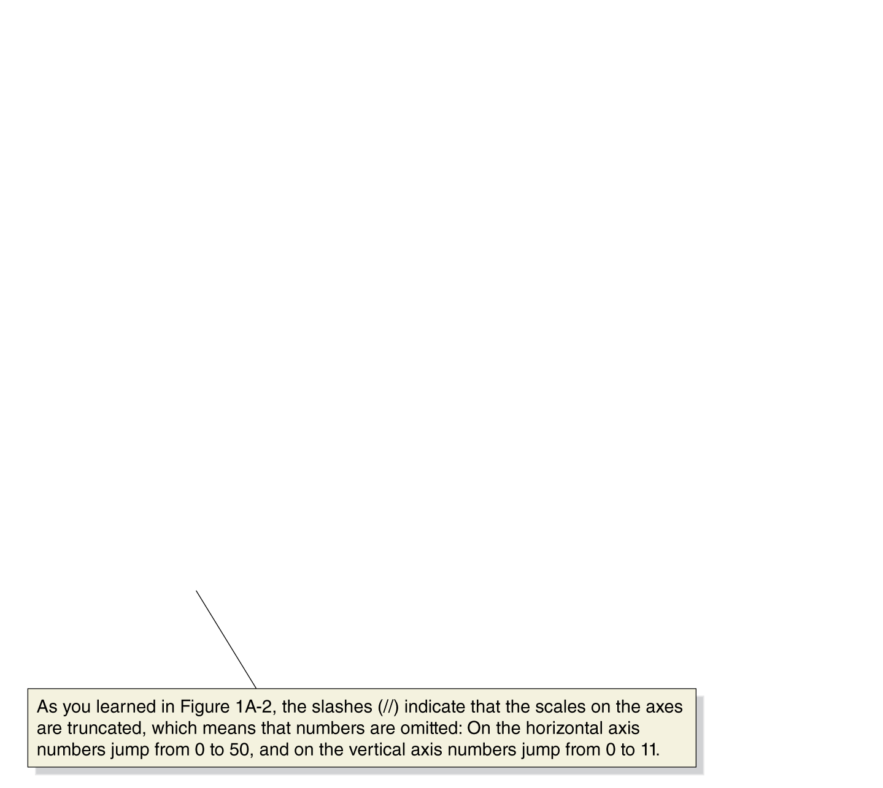
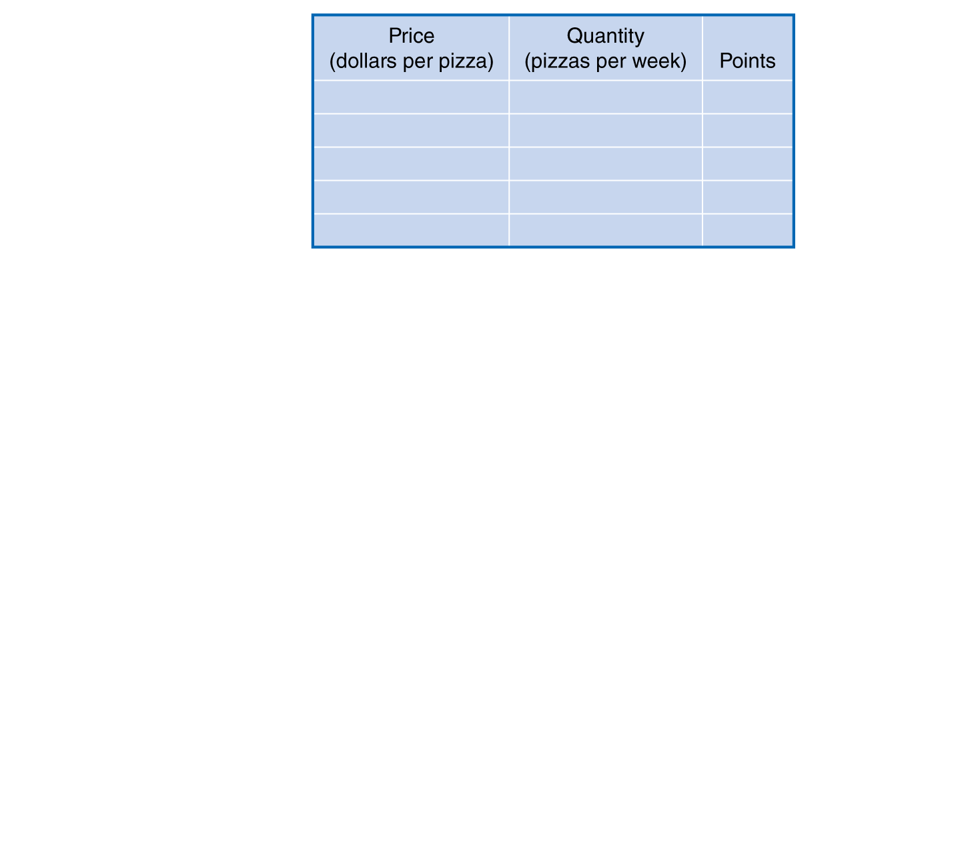
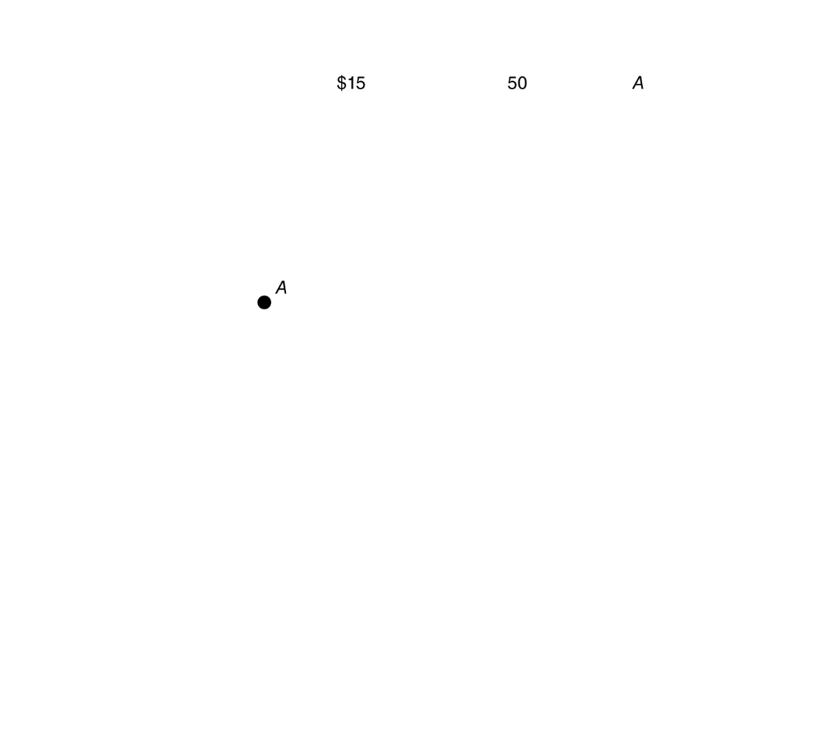
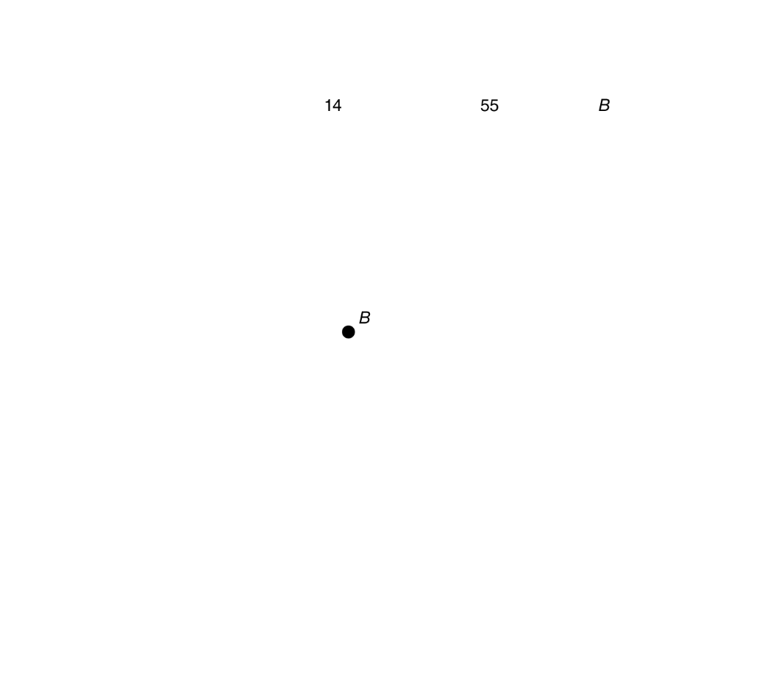
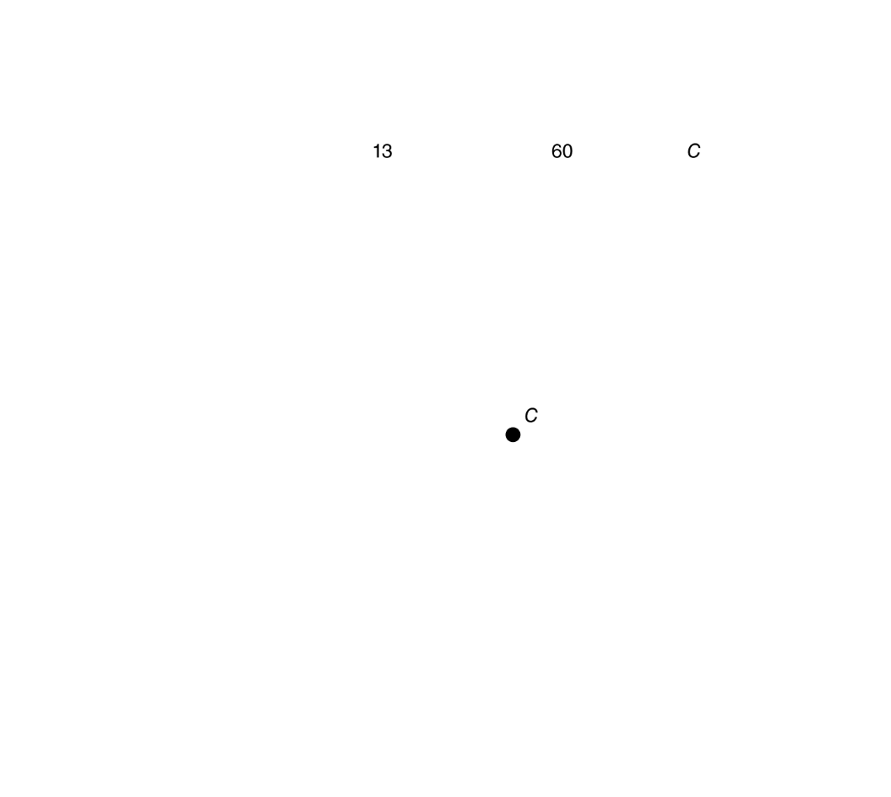
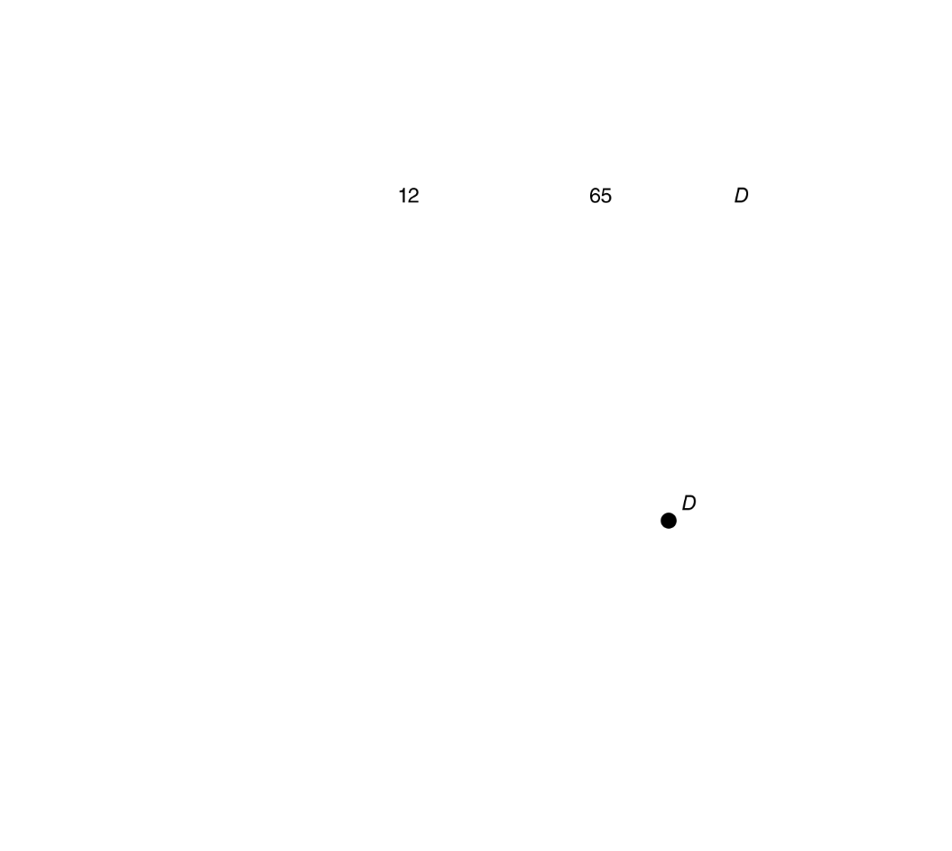
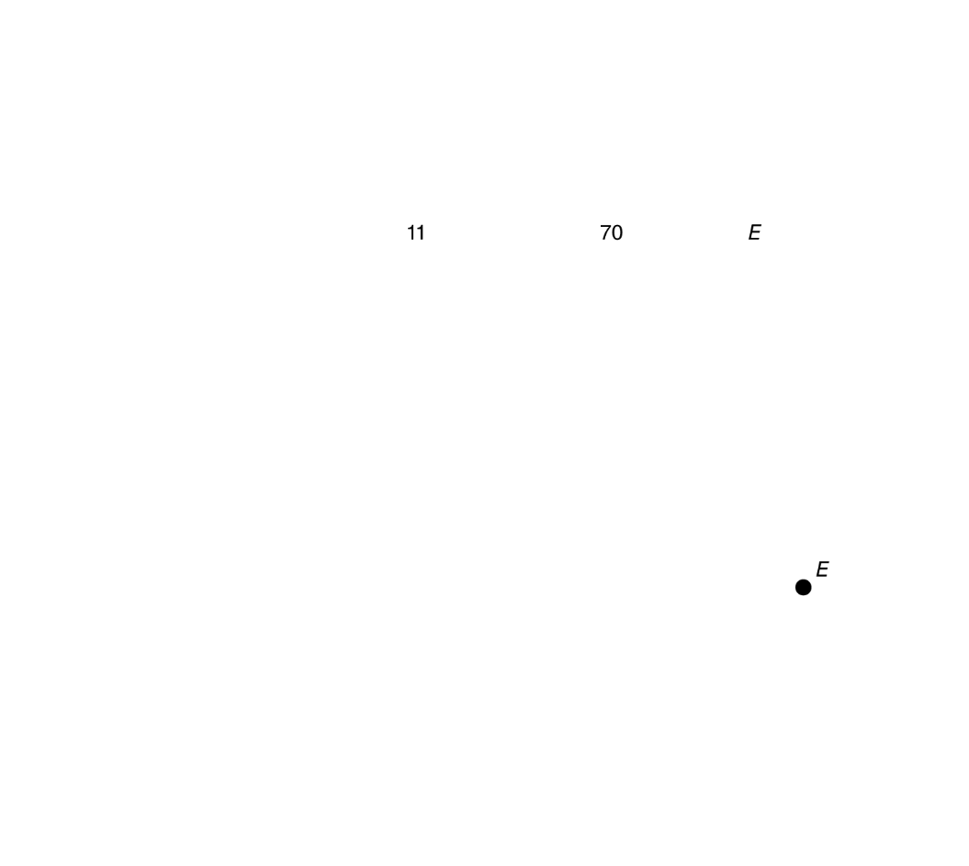
Graphs of two variables
The figure shows a two-dimensional grid on which we measure the price of pizza along the vertical axis (or y-axis) and the quantity of pizza sold per week along the horizontal axis (or x-axis).
Each point on the grid represents one of the price and quantity combinations listed in the table.
By connecting the points with a line, we can better illustrate the relationship between the two variables.
Figure 1A.3
Plotting Price and Quantity Points in a Graph
Notes:
The figure shows a two-dimensional grid on
which we measure the price of pizza along
the vertical axis (or y-axis) and the quantity
of pizza sold per week along the horizontal
axis (or x-axis). Each point on the grid represents
one of the price and quantity combinations
listed in the table. By connecting the
points with a line, we can better illustrate
the relationship between the two variables.

Slide 32
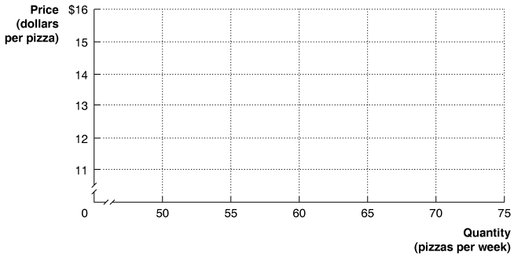
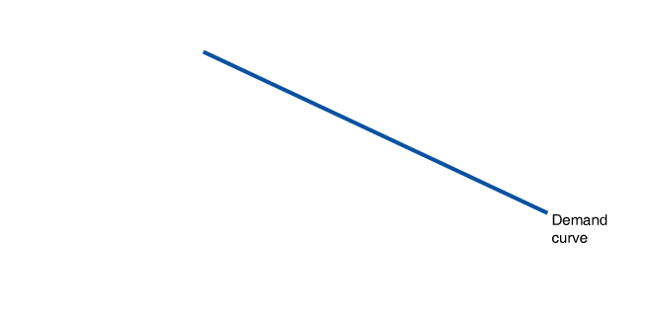
Calculating the slope of a line
We can calculate the slope of a line as the change in the value of the variable on the y-axis divided by the change in the value of the variable on the x-axis.
Because the slope of a straight line is constant, we can use any two points in the figure to calculate the slope of the line.
Figure 1A.4
Calculating the Slope of a Line
Notes:
We can calculate the slope of a line as the
change in the value of the variable on the
y-axis divided by the change in the value
of the variable on the x-axis. Because the
slope of a straight line is constant, we can
use any two points in the figure to calculate
the slope of the line. For example, when the
price of pizza decreases from $14 to $12, the
quantity of pizza demanded increases from
55 per week to 65 per week. So, the slope of
this line equals −2 divided by 10, or −0.2.

Slide 33
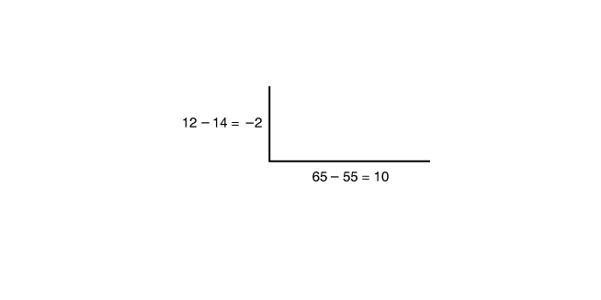
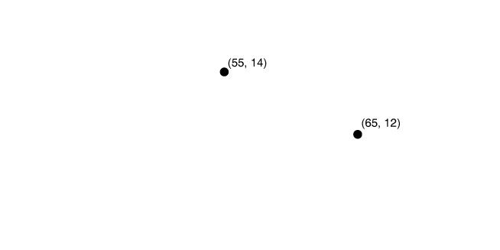
Calculating the slope of a line—continued
For example, when the price of pizza decreases from $14 to $12, the quantity of pizza demanded increases from 55 per week to 65 per week.
So, the slope of this line equals –2 divided by 10, or –0.2.
Figure 1A.4
Calculating the Slope of a Line

Slide 34
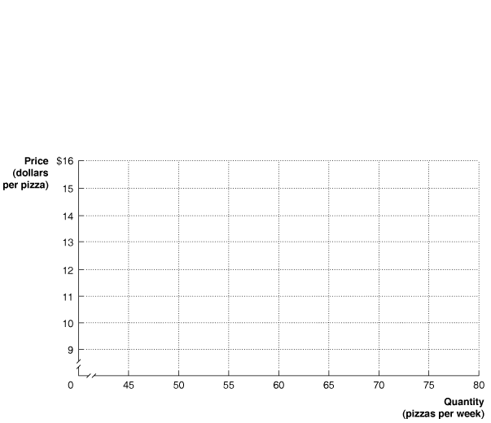
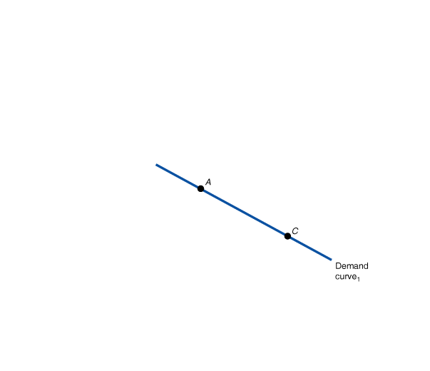
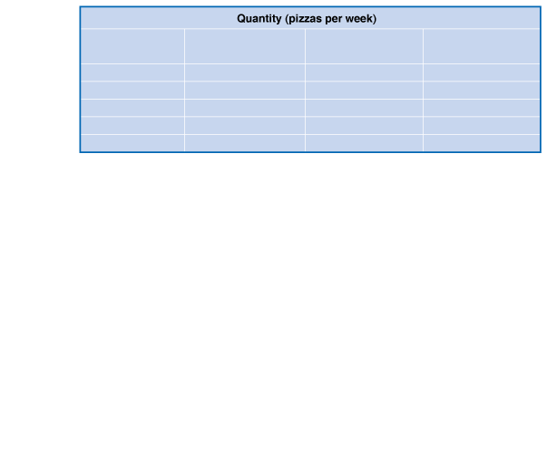
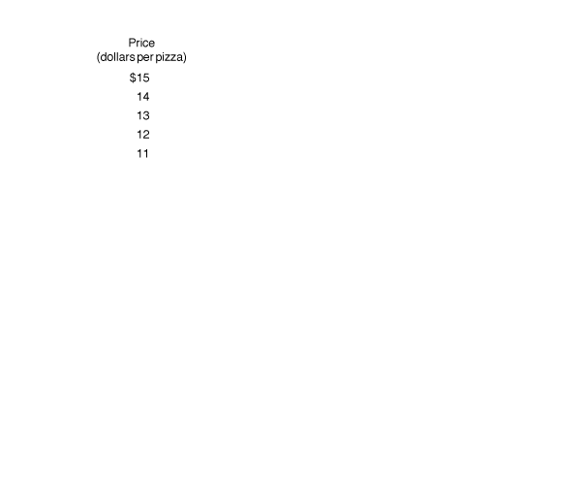
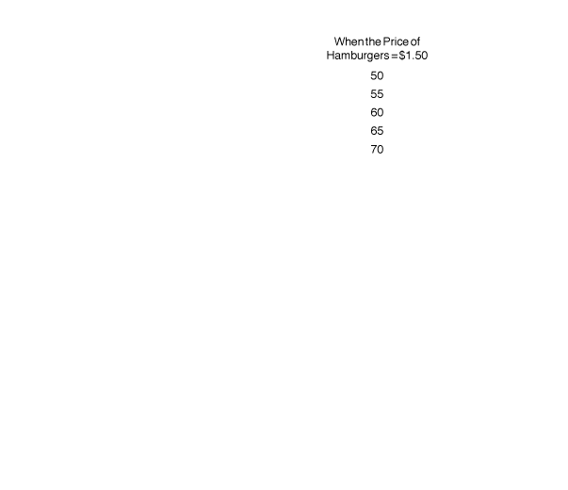
Showing three variables on a graph
The demand curve for pizza shows the relationship between the price of pizzas and the quantity of pizzas demanded, holding constant other factors that might affect the willingness of consumers to buy pizza.
Figure 1A.5
Showing Three Variables on a Graph
Notes:
The demand curve for pizza shows the relationship
between the price of pizzas and
the quantity of pizzas demanded, holding
constant other factors that might affect
the willingness of consumers to buy
pizza. If the price of pizza is $14 (point A),
an increase in the price of hamburgers from
$1.50 to $2.00 increases the quantity of pizzas
demanded from 55 to 60 per week (point
B) and shifts us to Demand curve2. Or, if
we start on Demand curve1 and the price
of pizza is $12 (point C), a decrease in the
price of hamburgers from $1.50 to $1.00
decreases the quantity of pizza demanded
from 65 to 60 per week (point D) and shifts
us to Demand curve3.

Slide 35
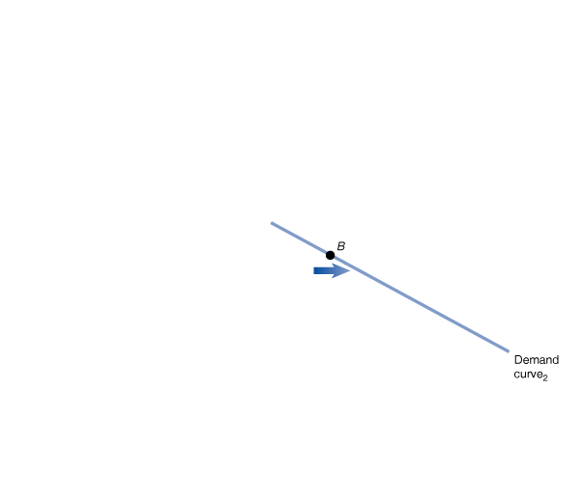
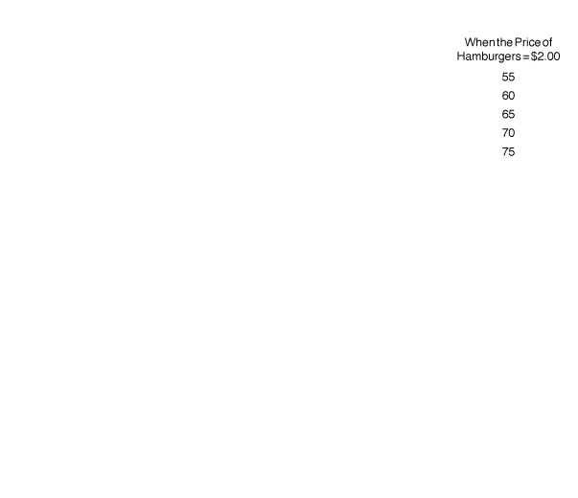
Showing three variables on a graph (part B)
If the price of pizza is $14 (point A), an increase in the price of hamburgers from $1.50 to $2.00 increases the quantity of pizzas demanded from 55 to 60 per week (point B) and shifts us to Demand curve₂.
Figure 1A.5
Showing Three Variables on a Graph

Slide 36
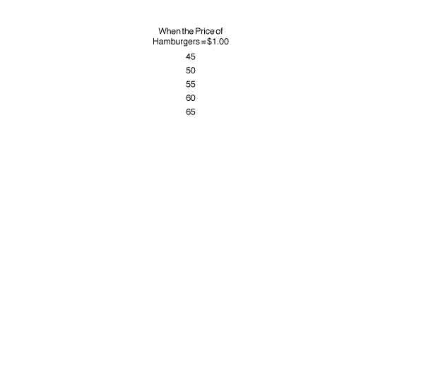
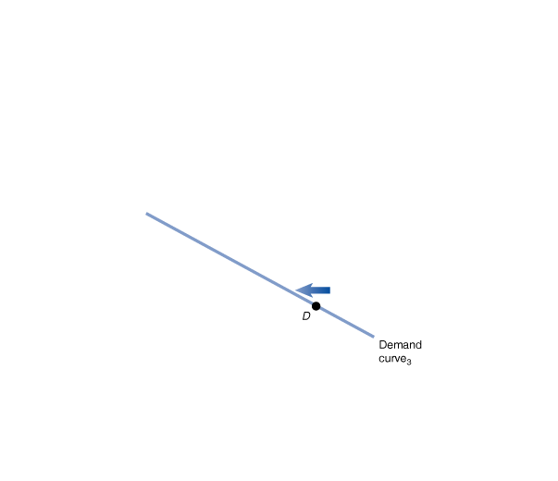
Showing three variables on a graph (part C)
Or, if we start on Demand curve₁ and the price of pizza is $12 (point C), a decrease in the price of hamburgers from $1.50 to $1.00 decreases the quantity of pizza demanded from 65 to 60 per week (point D) and shifts us to Demand curve₃.
Figure 1A.5
Showing Three Variables on a Graph

Slide 37
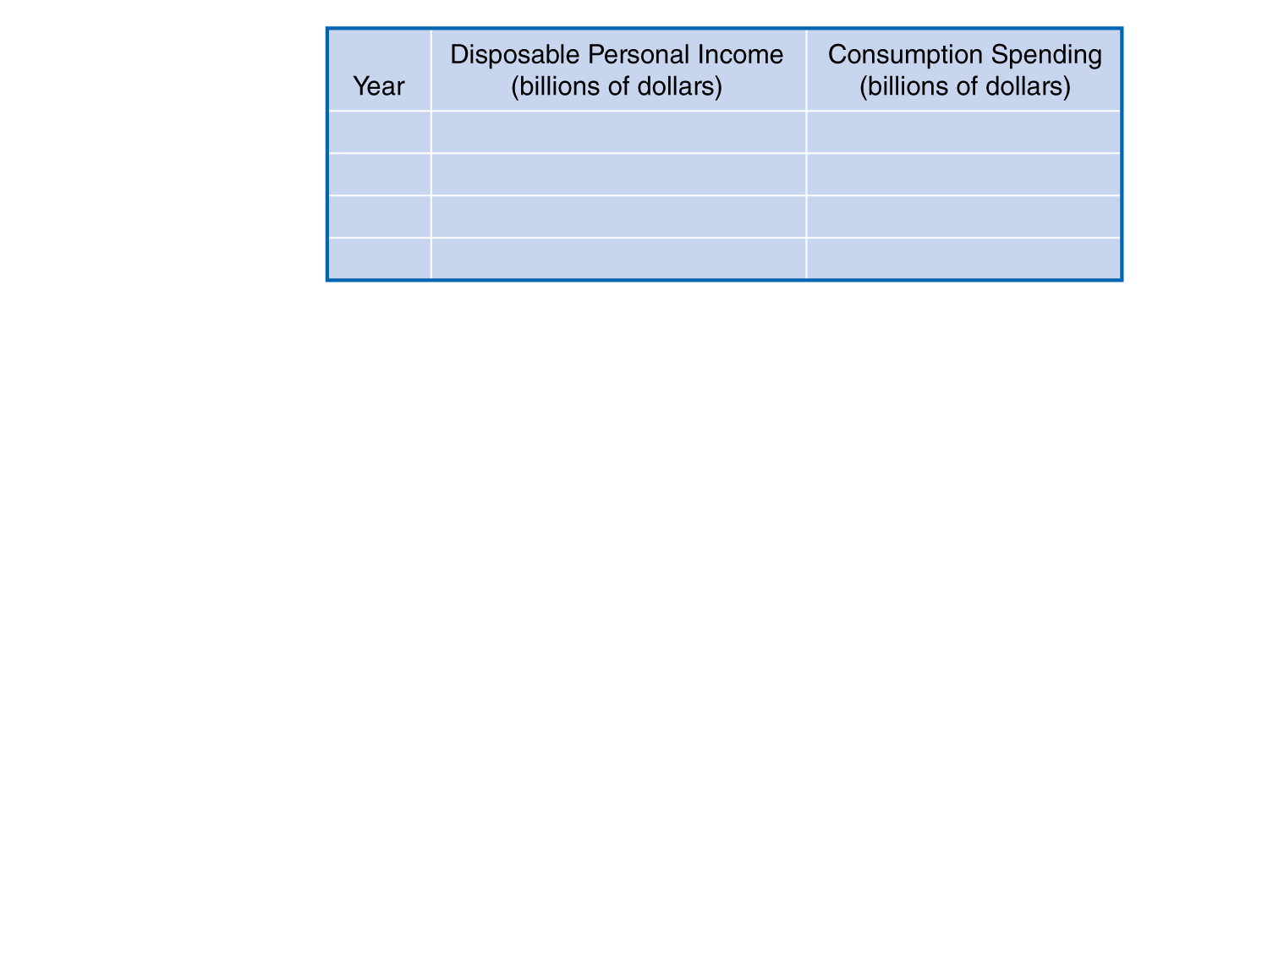
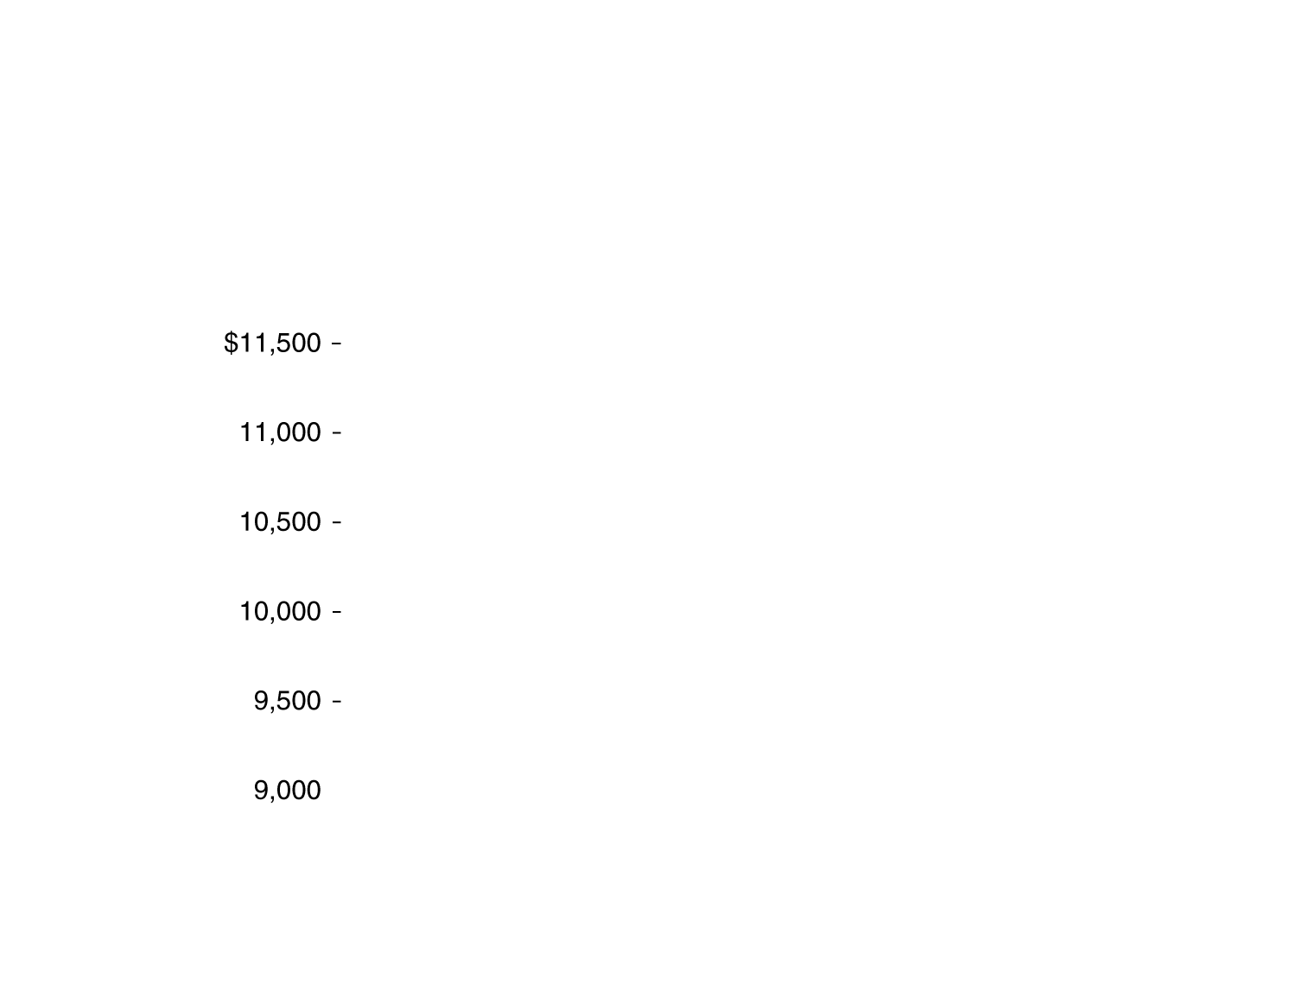
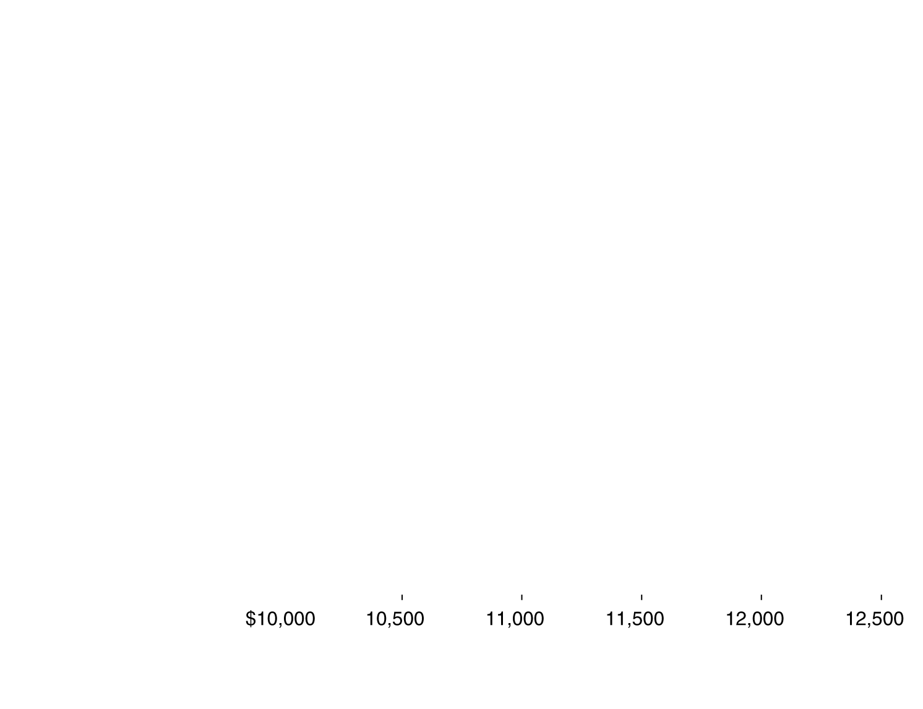
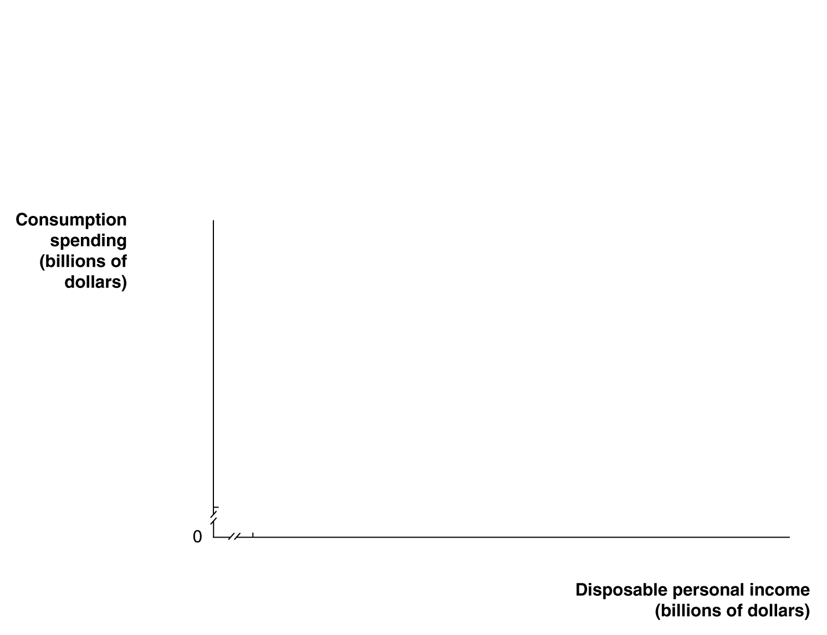

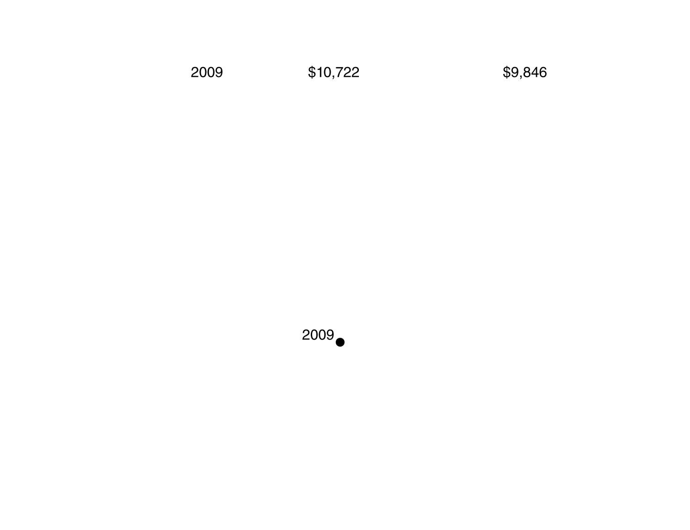
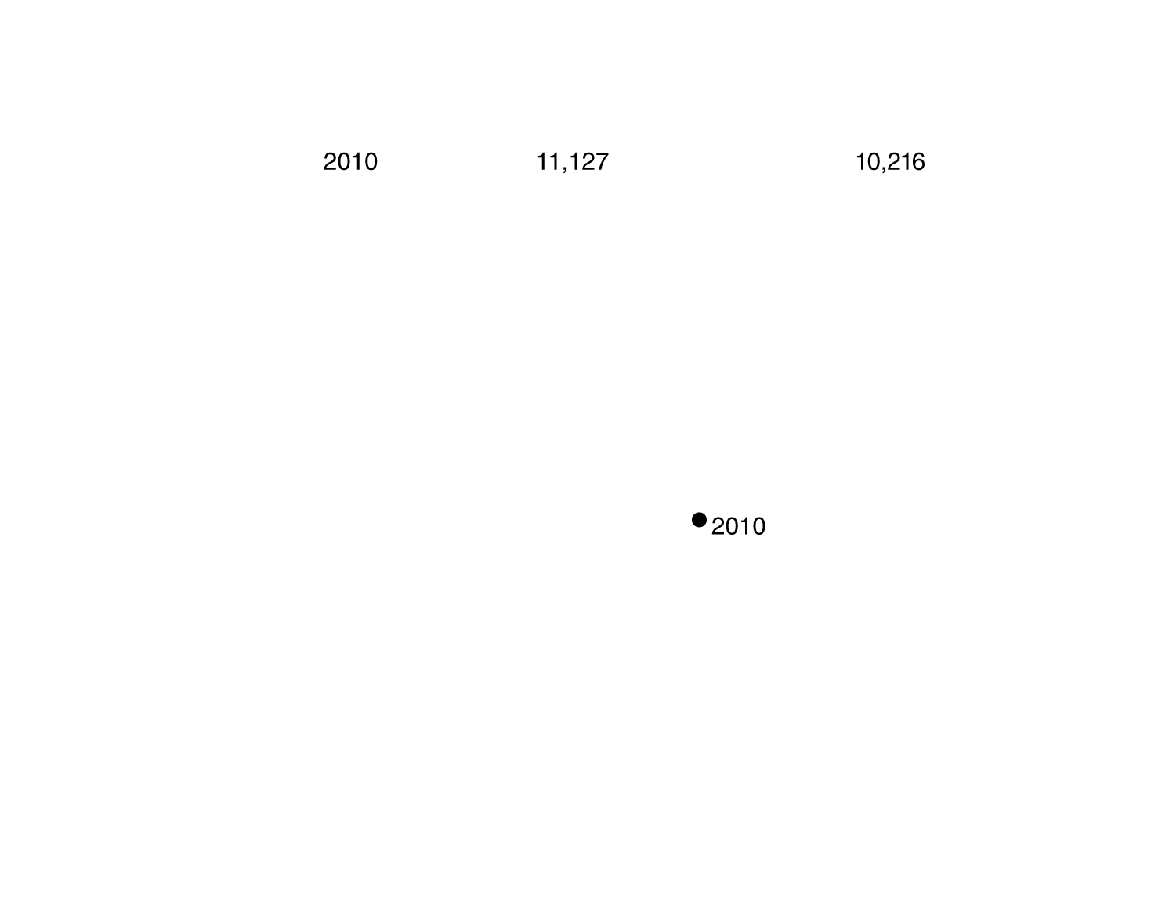
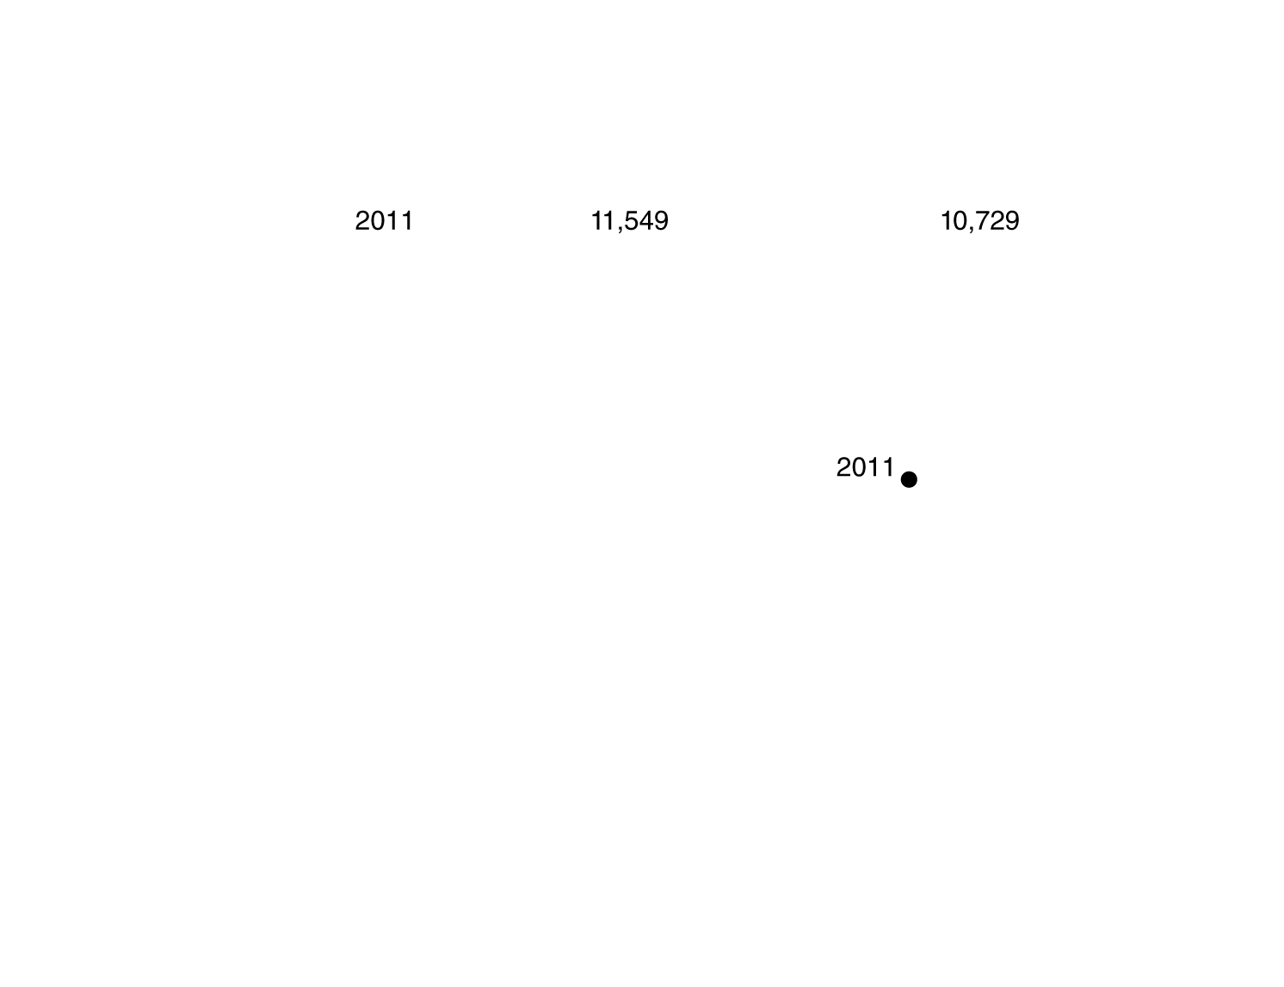
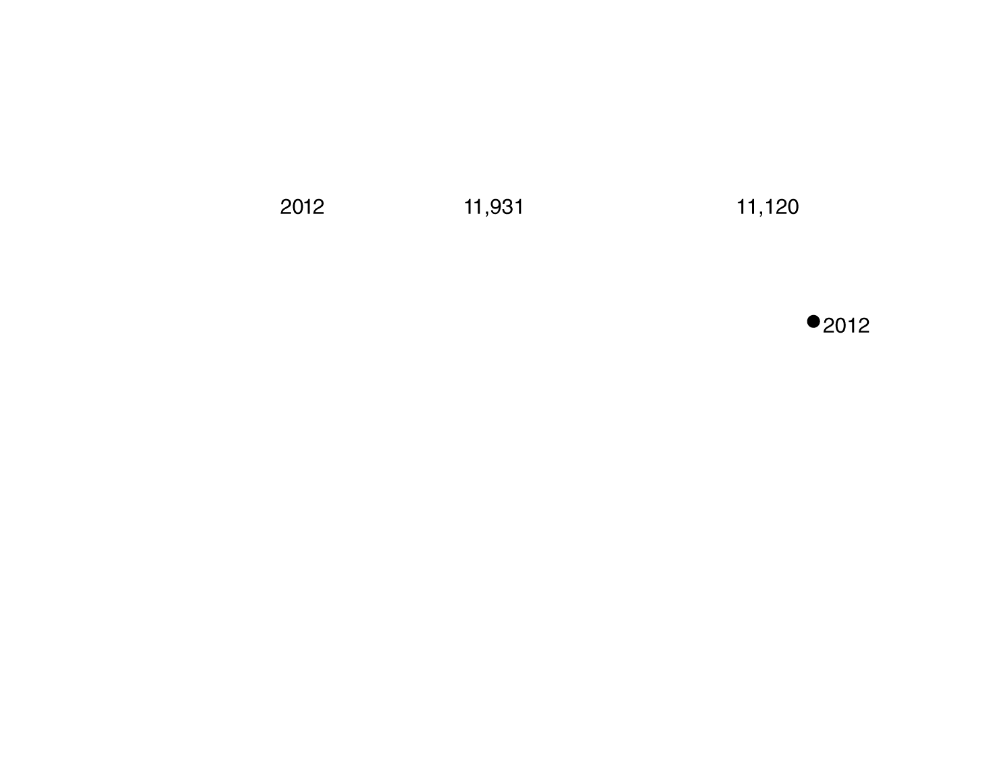
Positive and negative relationships
In a positive relationship between two economic variables, as one variable increases, the other variable also increases.
In a negative relationship, as one variable increases, the other decreases.
This figure shows the positive relationship between disposable personal income and consumption spending.
Figure 1A.6
Graphing the Positive Relationship Between Income and Consumption
Notes:
In a positive relationship between two economic
variables, as one variable increases,
the other variable also increases. This figure
shows the positive relationship between disposable
personal income and consumption
spending. As disposable personal income in
the United States has increased, so has consumption
spending.
Source: U.S. Department of Commerce, Bureau
of Economic Analysis.

Slide 38
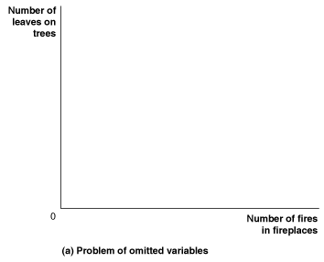
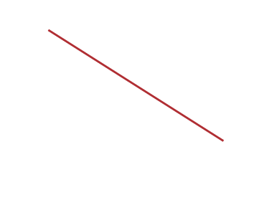
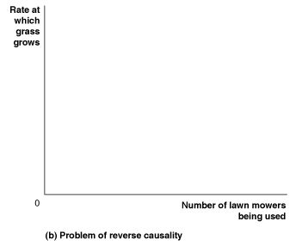

Correlation vs. causation
Figure 1A.7
Determining Cause and Effect
Using graphs to draw conclusions about cause and effect is dangerous.
For example, in panel (a), as the number of fires in fireplaces increases, the number of leaves on trees falls; but the fires don’t cause the leaves to fall.
In panel (b), as the number of lawn mowers being used increases, so does the rate at which grass grows.
Notes:
Using graphs to draw conclusions about cause and effect can be hazardous. In
panel (a), we see that there are fewer leaves on the trees in a neighborhood when
many homes have fires burning in their fireplaces. We cannot draw the conclusion
that using fireplaces causes the leaves to fall because we have an omitted
variable—the season of the year. In panel (b), we see that more lawn mowers are
used in a neighborhood during times when the grass grows rapidly and fewer lawn
mowers are used when the grass grows slowly. Concluding that using lawn mowers
causes the grass to grow faster would be making the error of reverse causality.

Slide 39
Are graphs of economic relationships always straight lines?
The relationship between two variables is linear when it can be represented by a straight line.
Few economic relationships are actually linear. However linear approximations are simpler to use, and are often “good enough” in modeling.

Slide 40
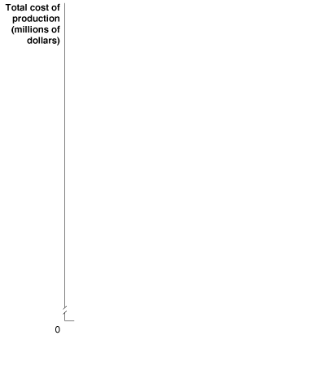
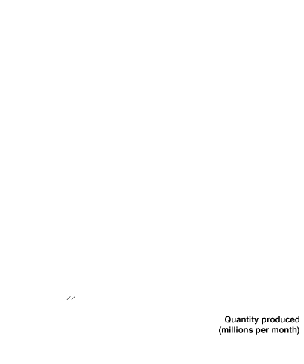
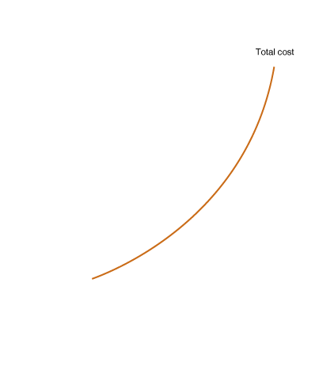
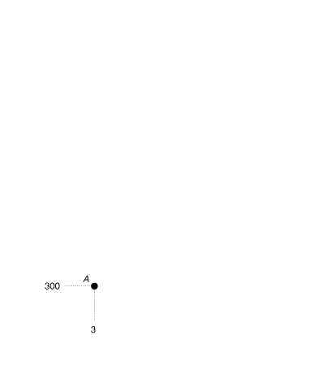
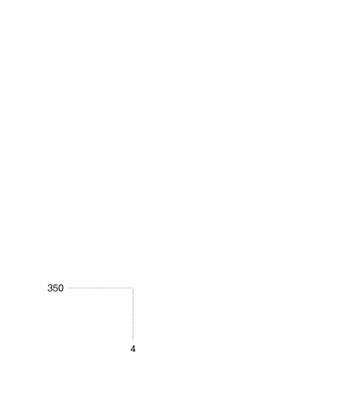








Slopes of non-linear curves
A non-linear curve has different slopes at different points. This curve shows the total cost of production for various quantities of iPhones.
We can approximate its slope over a section by measuring the slope as if that section were linear.
Between C and D, the slope is greater than between A and B; so we say the curve is steeper between C and D than between A and B.
Figure 1A.8a
The Slope of a Nonlinear Curve
Notes:
The relationship between the quantity of iPhones produced and the total cost of
production is curved rather than linear. In panel (a), when we move from point A
to point B, the quantity produced increases by 1 million iPhones, while the total
cost of production increases by $50 million. Farther up the curve, as we move
from point C to point D, the change in quantity is the same—1 million iPhones—
but the change in the total cost of production is now much larger—$250 million.
Because the change in the y variable has increased, while the change in the x variable
has remained the same, we know that the slope has increased. In panel (b),
we measure the slope of the curve at a particular point by calculating the slope of
the tangent line at that point. The slope of the tangent line at point B is 75, and the
slope of the tangent line at point C is 150.

Slide 41














Slopes of non-linear curves—continued
Another way to measure the slope of a non-linear curve is to measure the slope of a tangent line to the curve, at the point we want to know the slope.
Figure 1A.8b
The Slope of a Nonlinear Curve

Slide 42
Formula for a percentage change
One important formula is the percentage change, which is the change in some economic variable, usually from one period to the next, expressed as a percentage.
Notes:
The area of a rectangle is equal to its base
multiplied by its height. Total revenue is
equal to quantity multiplied by price. Here,
total revenue is equal to the quantity of
125,000 bottles times the price of $2.00 per
bottle, or $250,000. The area of the shaded
rectangle shows the firm’s total revenue.

Slide 43




The area of a rectangle
The area of a rectangle is equal to its base multiplied by its height; total revenue is equal to quantity multiplied by price.
Here, total revenue is equal to the quantity of 125,000 bottles times the price of $2.00 per bottle, or $250,000.
The area of the green-shaded rectangle shows the firm’s total revenue.
Figure 1A.9
Showing a Firm’s Total Revenue on a Graph

Slide 44




The area of a triangle
The area of a triangle is equal to ½ multiplied by its base multiplied by its height.
The area of the blue-shaded triangle has a base equal to
150,000 – 125,000, or 25,000, and a height equal to $2.00 – $1.50, or $0.50.
Therefore, its area equals ½ × 25,000 × $0.50, or $6,250.
Figure 1A.10
The Area of a Triangle
Notes:
The area of a triangle is equal to 1/2 multiplied
by its base multiplied by its height. The
area of the shaded triangle has a base equal
to 150,000 - 125,000, or 25,000, and a height
equal to $2.00 - $1.50, or $0.50. Therefore,
its area is equal to 1/2 * 25,000 * $0.50, or
$6,250.

Slide 45
Summary of using formulas
Whenever you must use a formula, you should follow these steps:
Make sure you understand the economic concept the formula represents.
Make sure you are using the correct formula for the problem you are solving.
Make sure the number you calculate using the formula is economically reasonable. For example, if you are using a formula to calculate a firm’s revenue and your answer is a negative number, you know you made a mistake somewhere.

